Slide 1
GENDER AND DISASTER RISK REDUCTION
PRESENTED BY:
CARMEN GRIFFITHS
CONSTRUCTION RESOURCE & DEVELOPMENT CENTRE - JAMAICA

Slide 2
DRR FROM A WOMAN’S POINT OF VIEW
LOOKING AT RECONSTRUCTION

Slide 3
WHO ARE WE?
CONSTRUCTION RESOURCE & DEVELOPMENT CENTRE A JAMAICAN DEVELOPMENT NGO
  WORKING ON DISASTER RECONSTRUCTION AND MAPPING
  WATER AND SANITATION
  HOUSING AND SAFETY IN CITIES
CONNECTED TO TWO INTERNATIONAL NETWORKS –
  GROOTS INTERNATIONAL
  HUAIROU COMMISSION

Slide 4
WOMEN’S INVOLVEMENT IN COMMUNITY DEVELOPMENT
ORGANIZES/MOBILIZER
CARE GIVERS
REPOSITORY OF COMMUNITY KNOWLEDGE
SUPPORT STRUCTURE
AGENDA SETTERS

Slide 5
THE CONTEXT
1989 – 2011 THERE HAS BEEN AN INCREASE IN THE FREQUENCY AND INTENSITY OF HURRICANES
WOMEN LIVING IN INFORMAL SETTLEMENTS IN CONDITIONS VULNERABLE TO DISASTERS
ROOFS ARE CONSTRUCTED OF TIMBER USUALLY WITHOUT CORRECT CONNECTIONS
50% OF HOUSEHOLDS ARE HEADED BY WOMEN

Slide 6
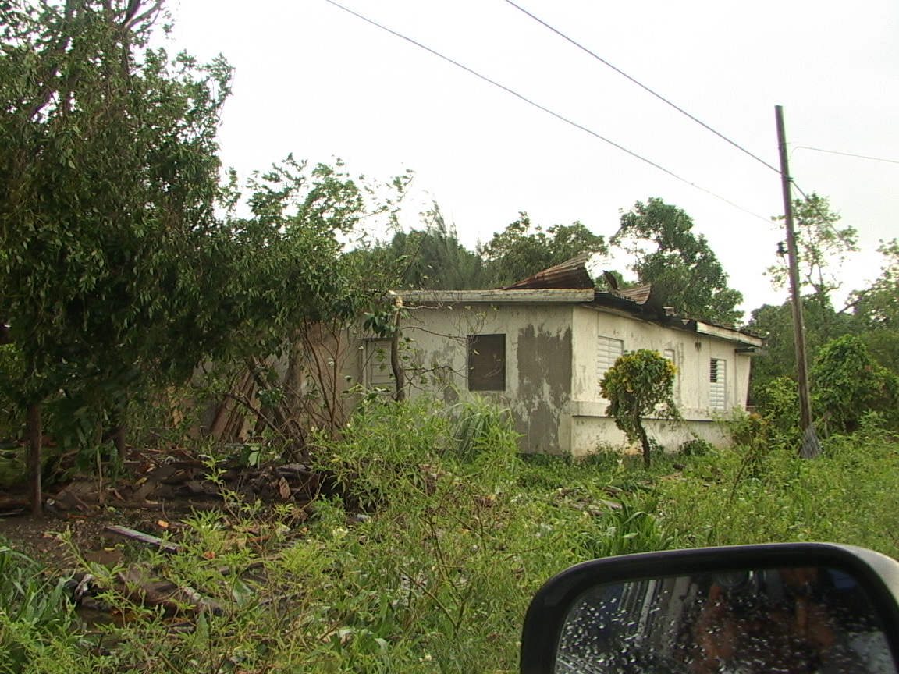
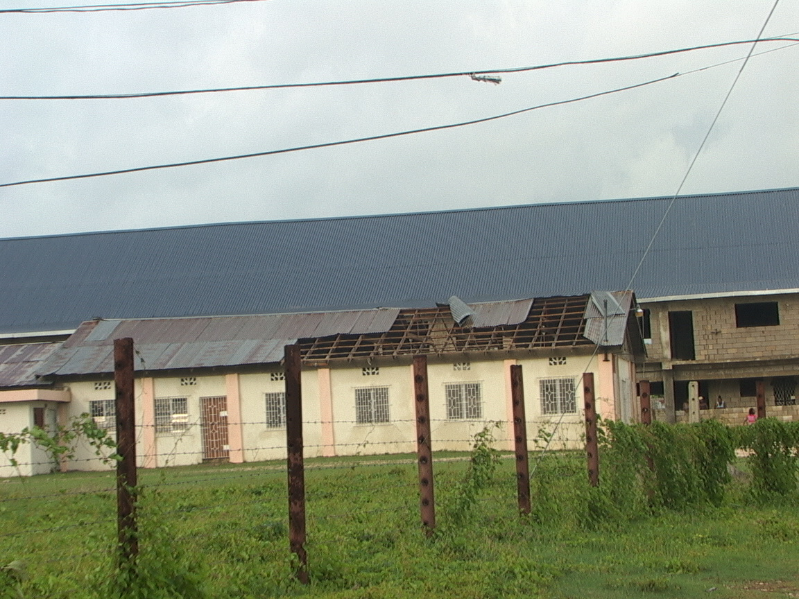
DAMAGE AFTER HURRICANE

Slide 7
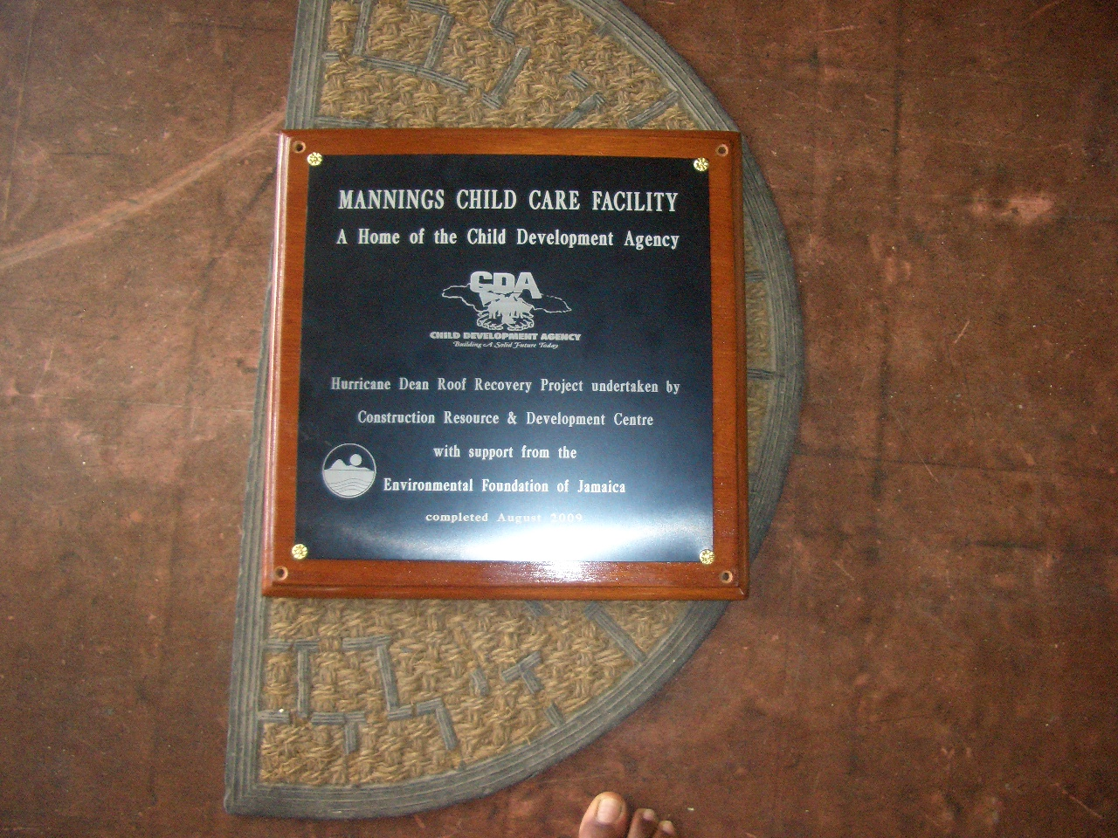
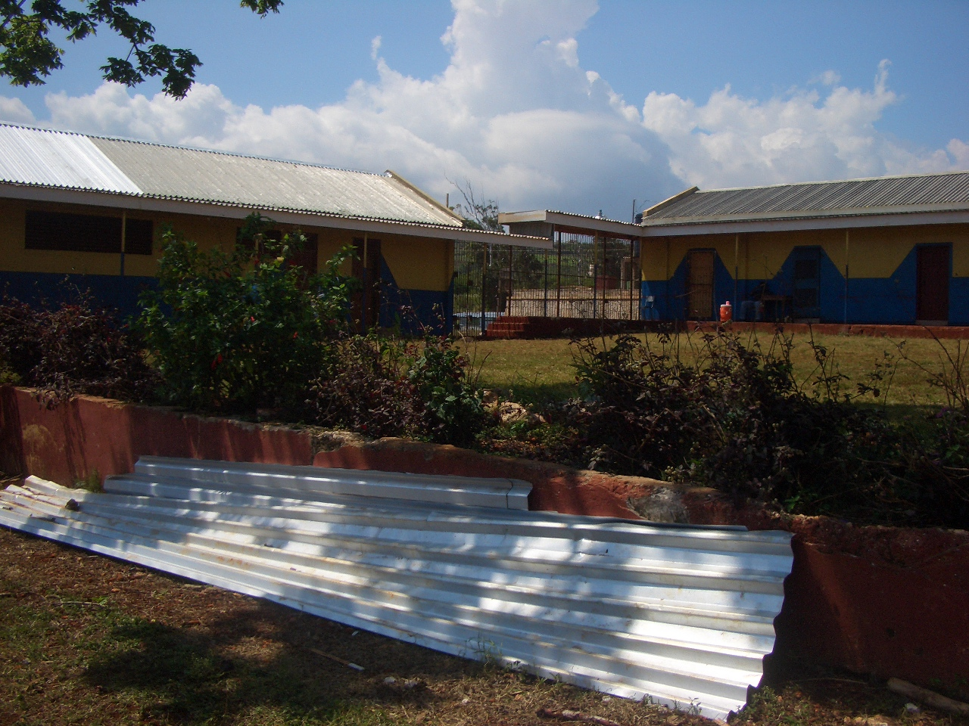
TRAINING WOMEN IN DRR
THE CRDC HAS SUPPORT WOMEN FOR 27 YEARS TO BECOME CONSTRUCTI ON WORKERS AND SAFETY MONITORS - WITH AN EMPHASIS ON DISASTER RISK REDUCTION

Slide 8
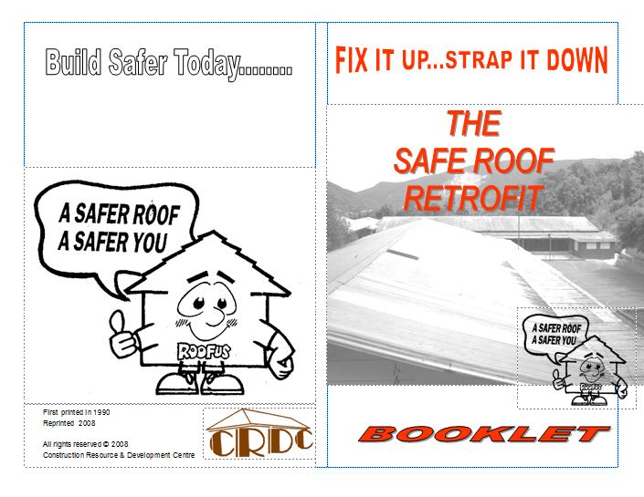


Build Safer Today........
FIX IT UP...STRAP IT DOWN
THE
SAFE ROOF
RETROFIT
First printed in 1990
Reprinted 2008
All rights reserved © 2008
Construction Resource & Development Centre
BOOKLET

Slide 9
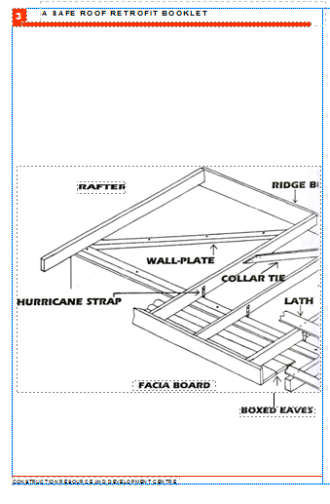
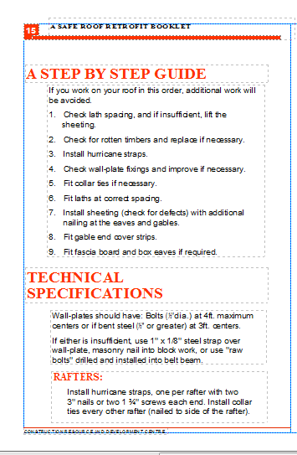


Slide 10
REDUCED VULNERABILITY
    COMMUNITY VULNERABILITY MAPS ARE DEVELOPED
    COMMUNITY ASSETS ARE PROTECTED THROUGH RETROFITTING

Slide 11
THE RESULT
    WOMEN TAKE CHARGE OF REDUCING THEIR VULNERABILITIES BY LEADING RETROFITTING, MONITORING CONSTRUCTION AND ADVOCATING FOR SAFE COMMUNITY INFRASTRUCTURE

Slide 12
OUR CHALLENGES
WOMEN’S EFFORTS ARE NOT GOING TO SCALE BECAUSE:
  RETROFIT AND DRR PROGRAMMES ARE TURF ORIENTED
  GENDER POLICIES AND NOT IMPLEMENTED AND BE DEVELOPED OR MONITORED.
  GOVERNMENTS AND OTHER INSTITUTION BECOME INDIFFERENT TO FORMALISING COMMUNITY WOMENS PARTICIPATION IN DRR.

Slide 13
RECOMMENDATIONS
REGIONAL AND UN INSTITUTIONS ENCOURAGE NATIONAL GOVERNMENTS TO SET ASIDE BUDGET RESOURCES FOR WOMEN’S PARTICIPATION IN NON TRADITIONAL DRR PROGRAMS AS MONITORS OF CONSTRUCTION AND BASIC SERVICES

Slide 14
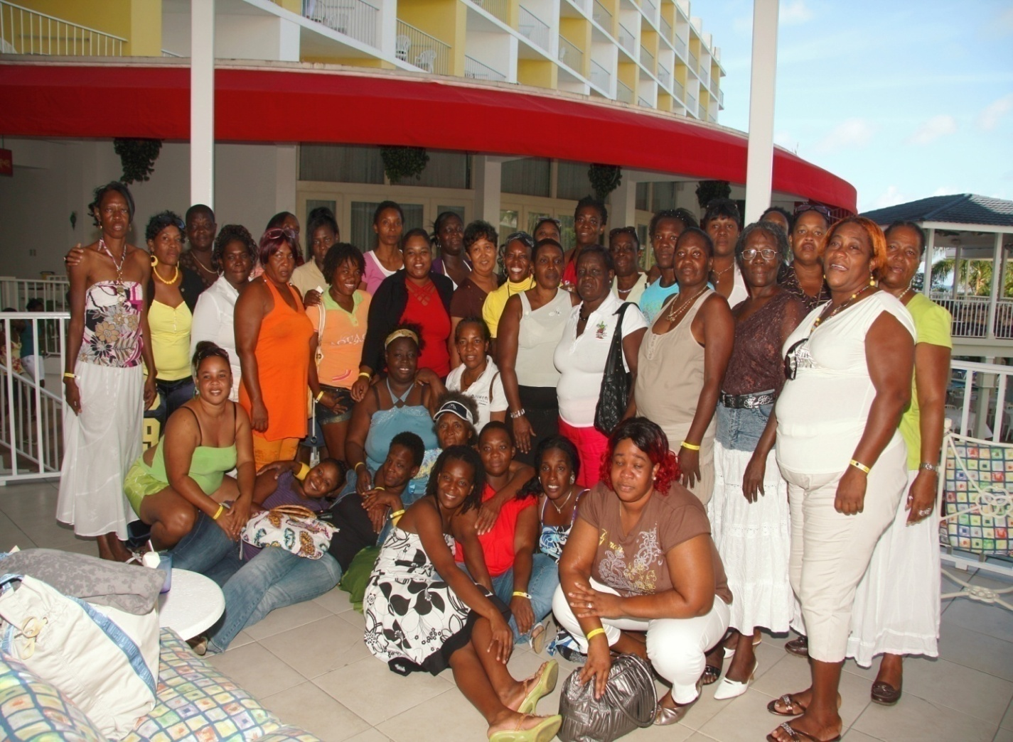
POWERFUL JAMAICA
WOMEN LEADERS MAKING A CHANGE

